Slide 1
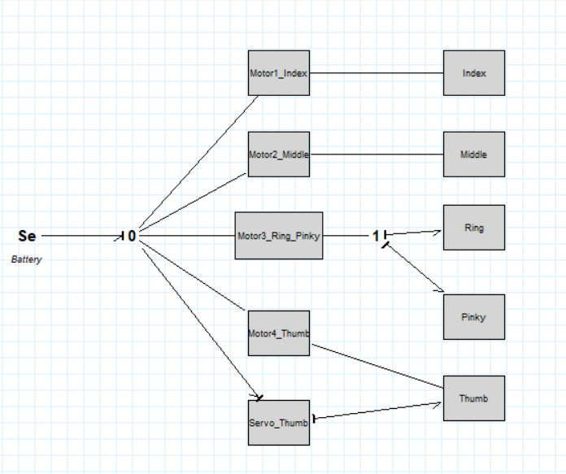
Comprehensive
Mechatronic Prosthetic Hand
Bond Graph Modeling & Simulation
Mechatronics Programming for Real-time Systems (MCTR 1015)
Team 5
Bassam Walid 55-0499
Youssef Mohamed 55-1031

Slide 2
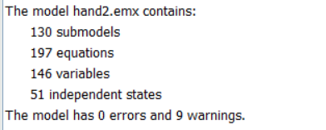
Project aim
Bond Graph Prosthetic Hand
Aim
Build a complete 20-sim Bond Graph model that converts electrical input voltage into motor torque, tendon force, and finger flexion to help in studying prosthetic hand actuation.
3
0.835 s
40 N
0 errors
battery voltage input cases
12 V, 7.2 V, 3.7 V
physical flexion time
from thesis validation
motor-applied force
used for validation
final 20-sim model
with 9 warnings
Team 5 | MCTR 1015 | 2

Slide 3
System architecture in 20-sim
Bond Graph Prosthetic Hand
Energy flow
Battery voltage is applied as an effort source.
Motors convert electrical effort into rotational mechanical power.
Gearbox and spool transform rotation into tendon pulling motion.
Finger submodels distribute tendon effort to MCP, PIP, and DIP joints.
The thumb has two modeled paths: motor-driven flexion and servo-driven second motion.
The model was simplified around finger flexion because flexion behavior is the main objective of the project.
Team 5 | MCTR 1015 | 3

Slide 4
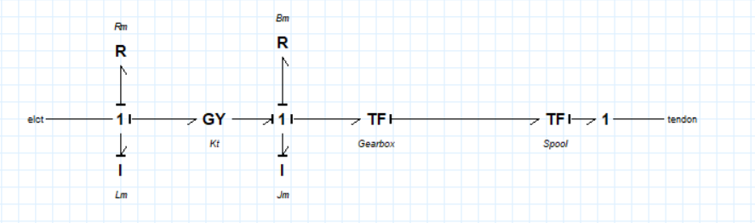
Motor submodel: electrical to tendon motion
Bond Graph Prosthetic Hand
Main elements
R and L represent motor winding resistance and inductance.
GY element represents the motor torque/back-EMF constant.
Jm and Bm model rotor inertia and mechanical friction.
Gearbox and spool transform motor rotation into tendon pulling motion.
Simplification of the motor
All five motors use the same electrical and mechanical motor parameters which were research but some of them were estimated. Improvements can be done where the values could be measured
Team 5 | MCTR 1015 | 5

Slide 5
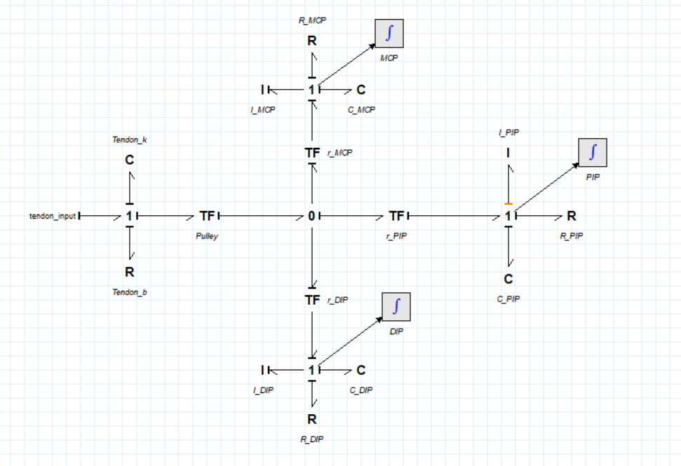
Finger flexion submodel
Bond Graph Prosthetic Hand
Index, middle, ring and pinky fingers
The tendon input passes through a pulley transformer.
The central 0-junction distributes the tendon motion to the three joints.
MCP, PIP and DIP each include inertia, compliance, and damping.
Output angles are obtained by integrating joint flow at each joint.
Because all non-thumb fingers were given the same parameter values, only one set of finger plots is shown in the results section.
Team 5 | MCTR 1015 | 6

Slide 6
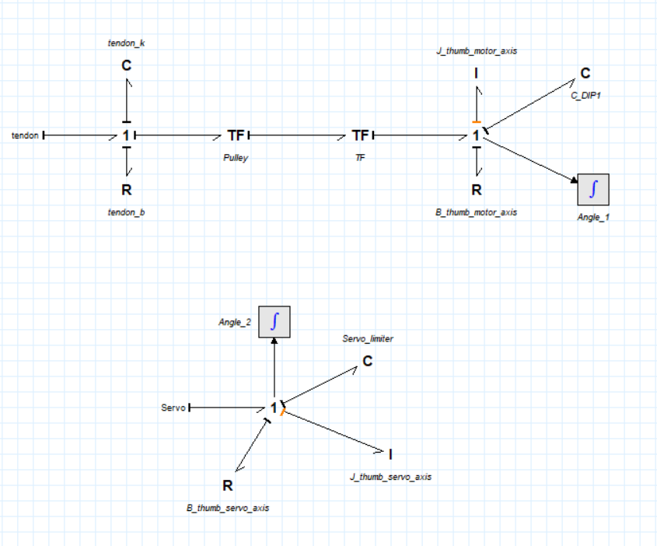
Thumb model: two simplified motion paths
Bond Graph Prosthetic Hand
Why the thumb was simplified
The thumb requires a different motion than the fingers, it was modelled as a 3-joint finger as most prosthetic thumbs only have two degrees of freedom.
The motor path models tendon-driven thumb flexion.
The servo path represents the second thumb angle with inertia, damping, and a limiter
Main limitation: the servo second angle flexed in around 40 s and could not be corrected by parameter tuning alone.
Team 5 | MCTR 1015 | 7

Slide 7
Model equations and selected state-space form
Bond Graph Prosthetic Hand
The full model is large; therefore, the report presents one finger submodel.
State | 20-sim definition
x1 · Tendon_k\state = int(Tendon_k\p.f)
x2 · I_MCP\state = int(I_MCP\p.e)
x3 · C_MCP\state = int(C_MCP\p.f)
x4 · I_DIP\state = int(I_DIP\p.e)
x5 · C_DIP\state = int(C_DIP\p.f)
x6 · C_PIP\state = int(C_PIP\p.f)
Representative equations
ẋ₁ = u
ẋ₂ = −x₂ − 2/3 x₃ + 1/3 x₅ + 1/3 x₆ + 1/3 u
ẋ₃ = x₂
ẋ₄ = −x₄ + 1/3 x₃ − 2/3 x₅ + 1/3 x₆ + 1/3 u
ẋ₅ = x₄
ẋ₆ = −x₂ − x₄ + u
Team 5 | MCTR 1015 | 8

Slide 8
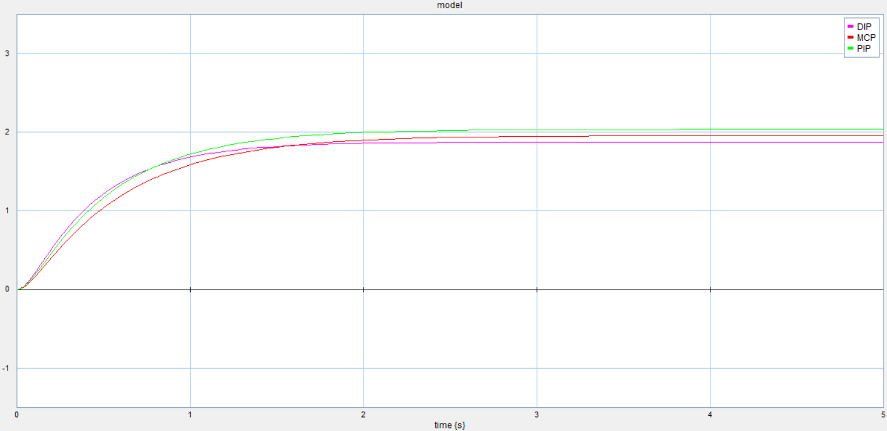
Results: non-thumb finger response at 12 V
Bond Graph Prosthetic Hand
Observation
All three joint angles rise smoothly and settle without oscillation.
The curve shape confirms the effect of the elastic and damping elements.
PIP reaches the largest final angle, followed by MCP and DIP.
The final 12 V response is the closest case to the desired strong gripping behavior.
Displayed joints: DIP, MCP, PIP
Team 5 | MCTR 1015 | 11

Slide 9
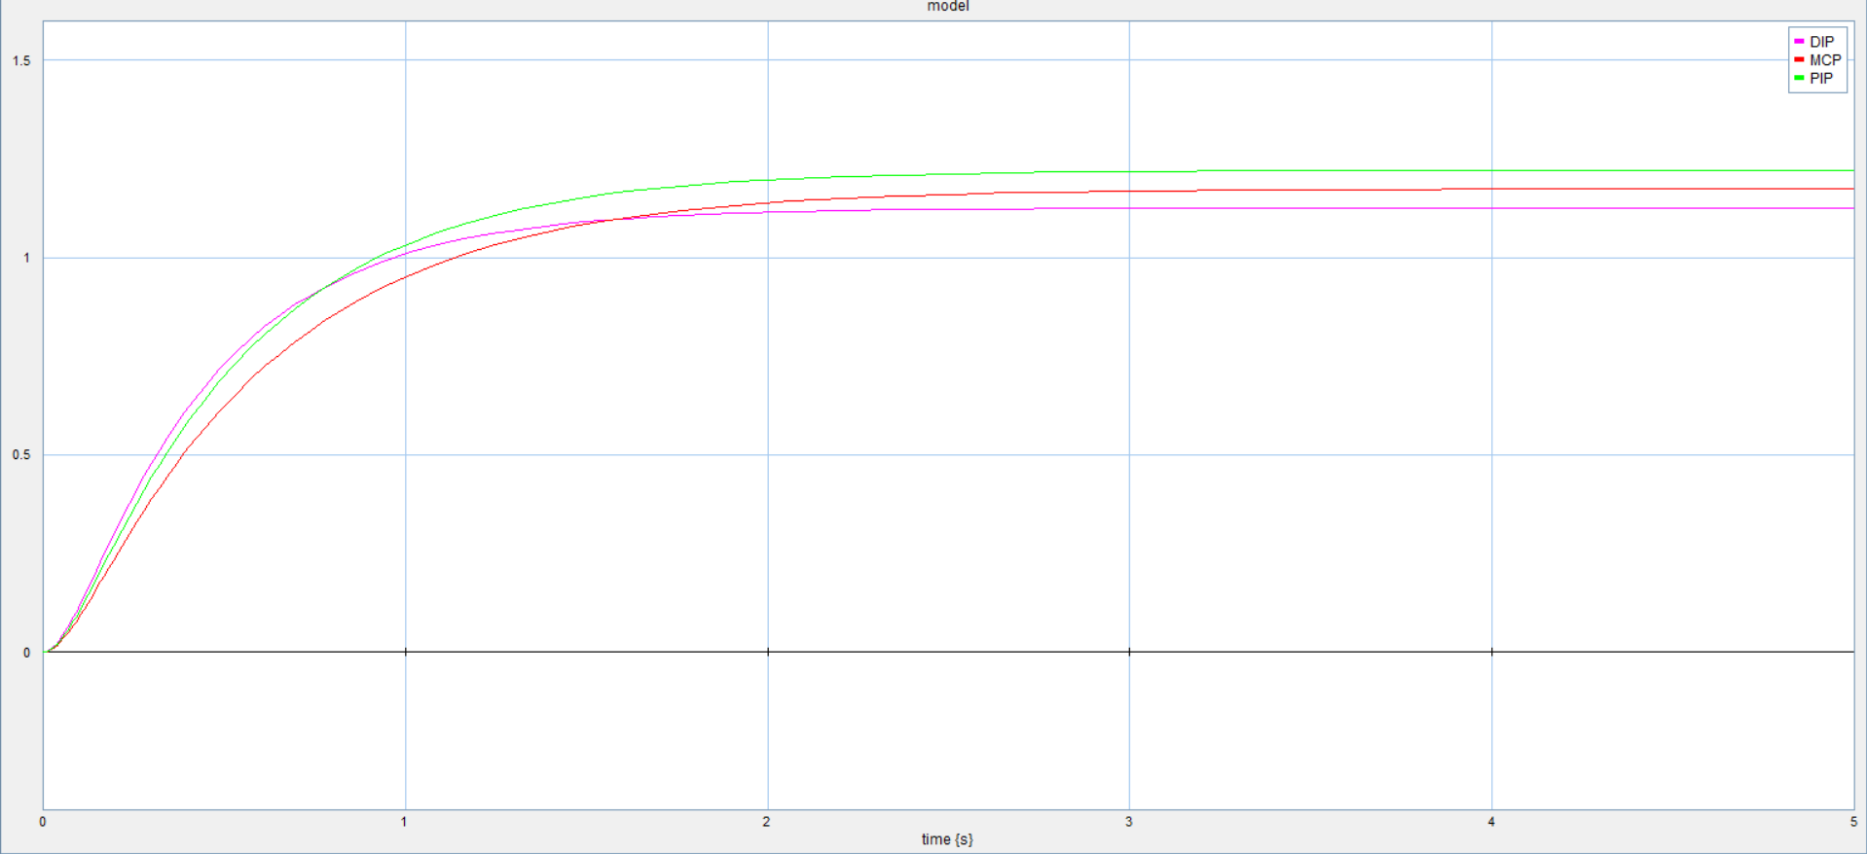
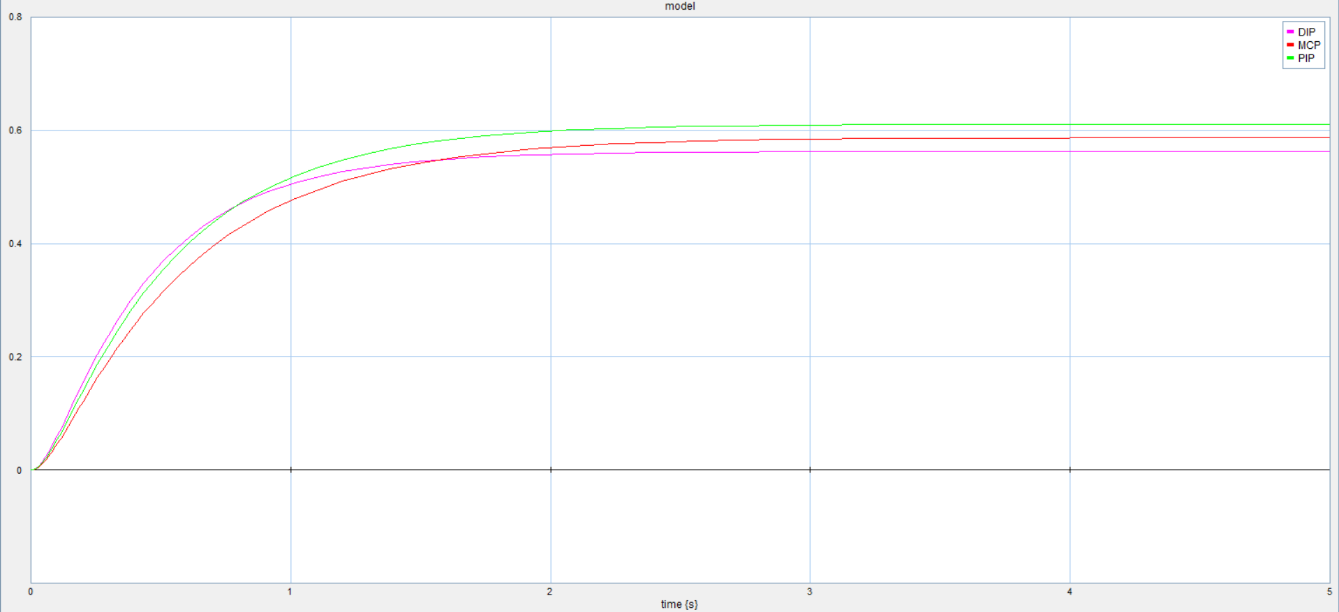
Results: effect of battery discharge on finger flexion
Bond Graph Prosthetic Hand
12 V
7.2 V
3.7 V
Comparison summary
Interpretation
Higher battery effort gives higher final joint angles.
Lower charge reduces the effective gripping range.
The response remains stable; the main change is final flexion amplitude.
The model captures a practical prosthetic-hand issue: as the battery loses charge, the same command no longer produces the same tendon force, and the finger cannot grip as strongly.
Team 5 | MCTR 1015 | 12

Slide 10
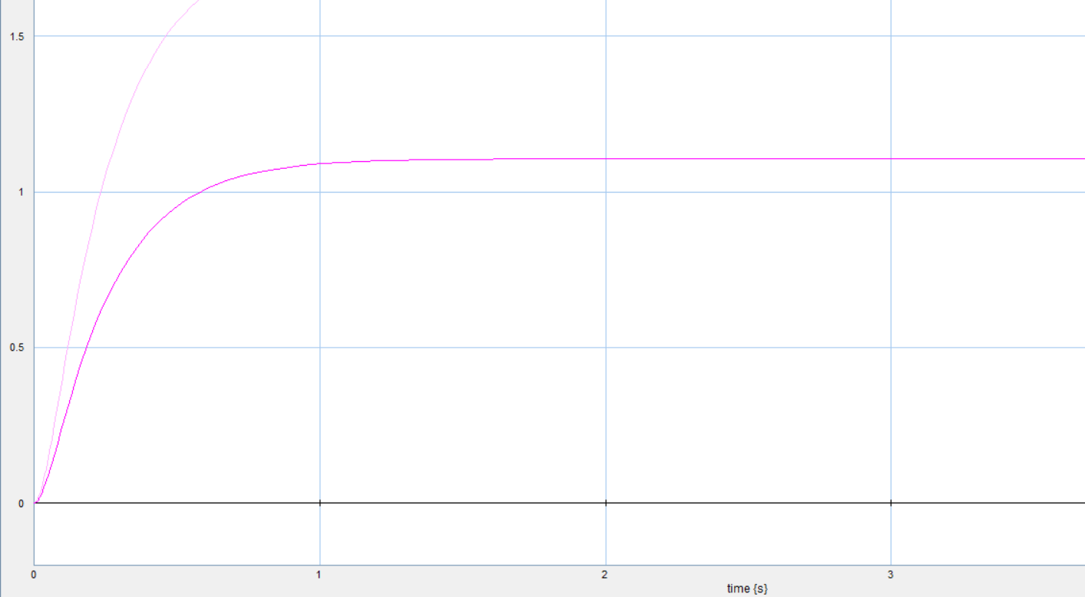
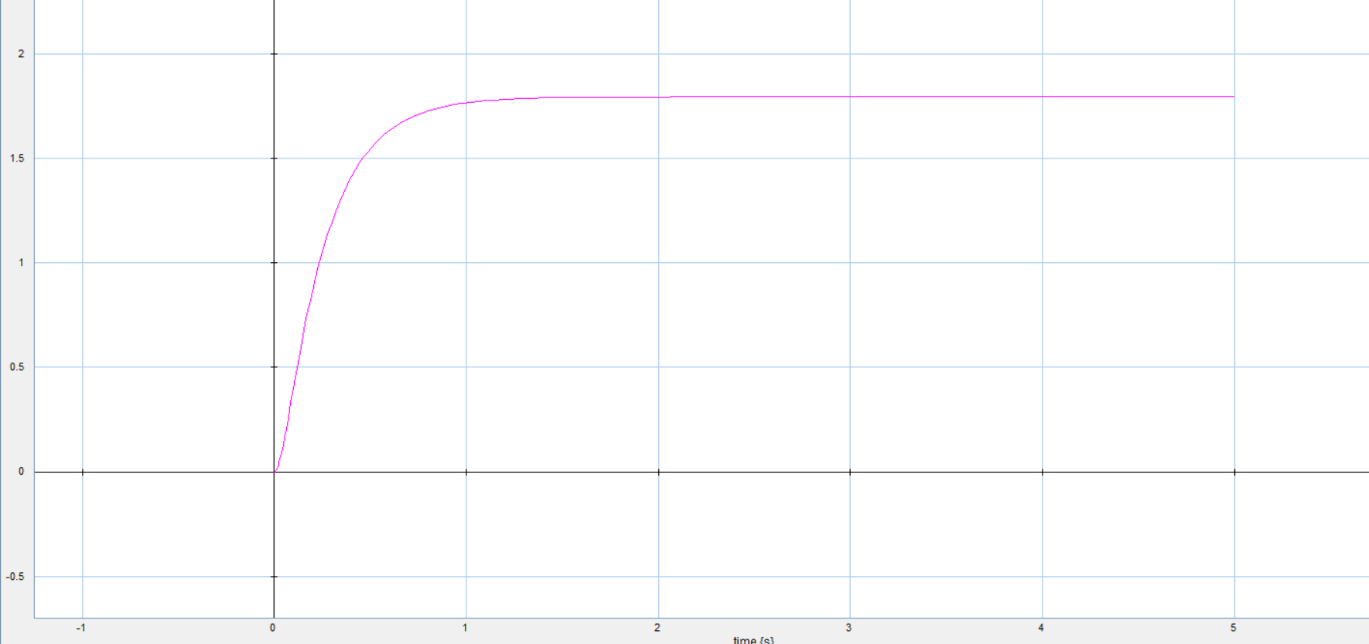
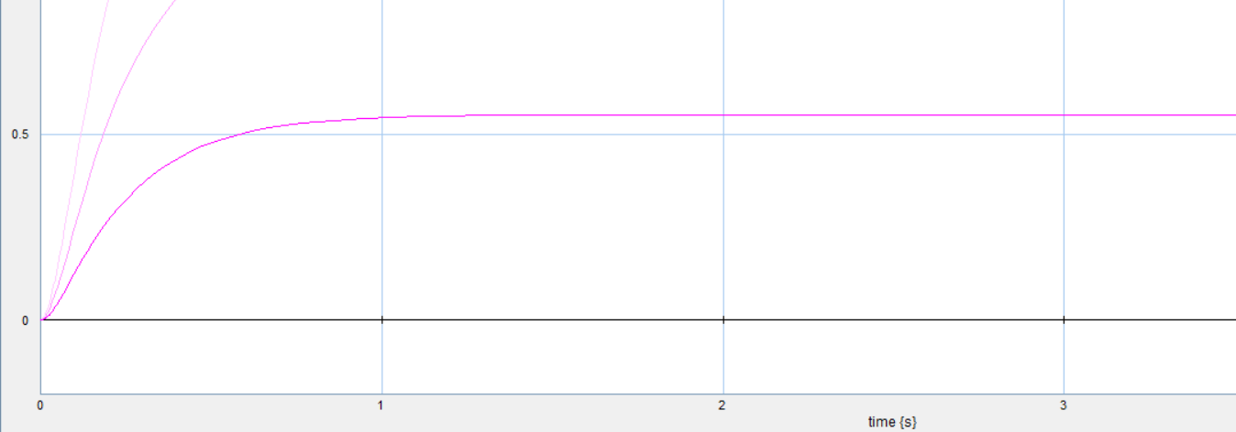
Results: thumb motor-driven flexion
Bond Graph Prosthetic Hand
The thumb motor path behaves similarly to the fingers: higher input voltage increases final flexion and produces a faster, stronger response.
Team 5 | MCTR 1015 | 13

Slide 11
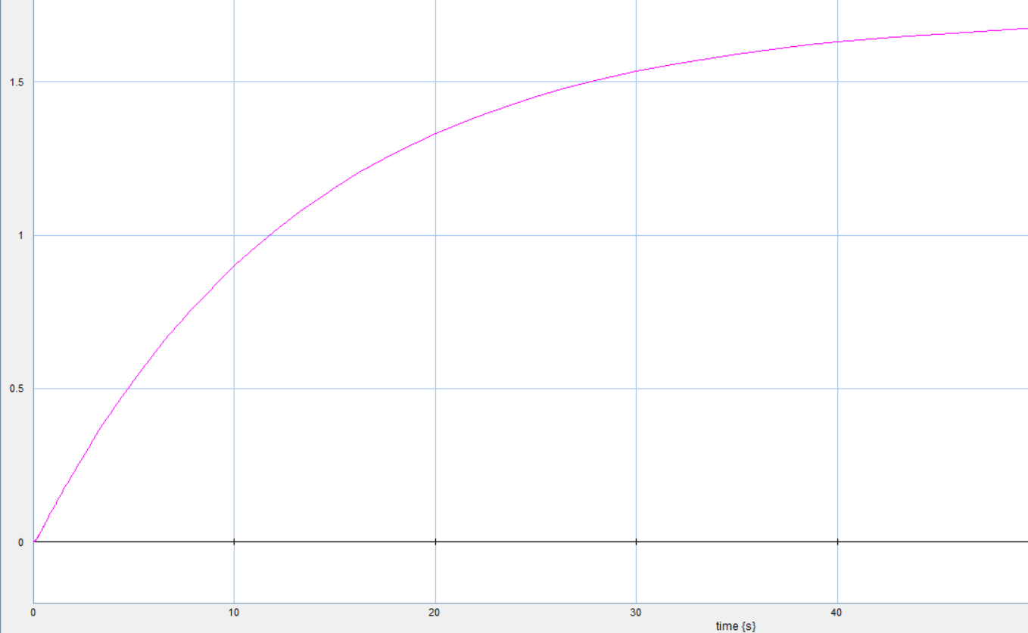
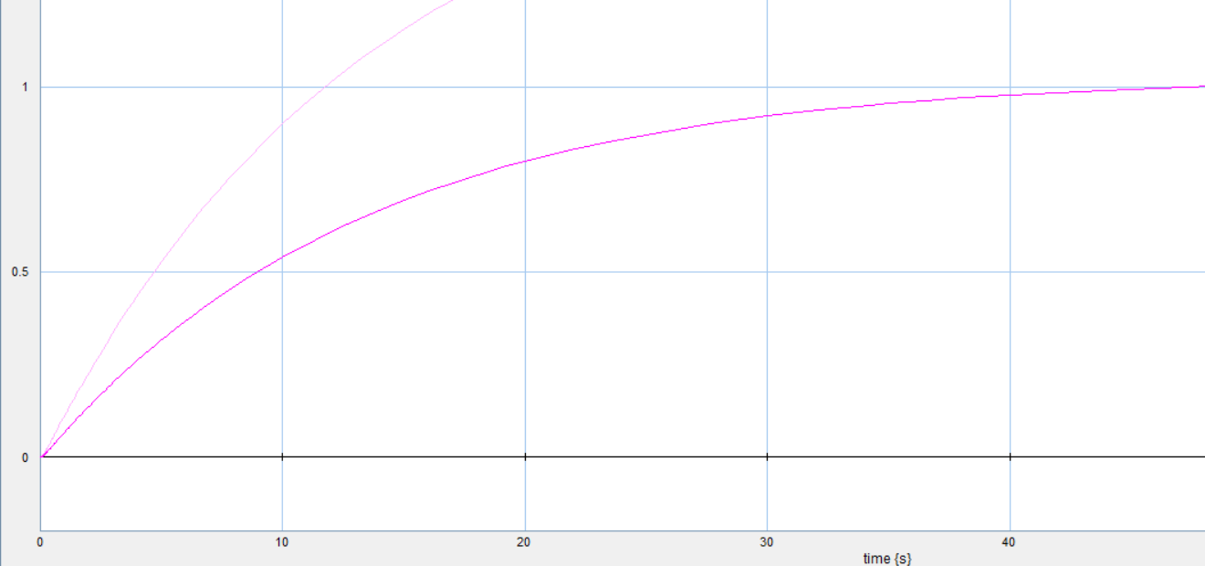
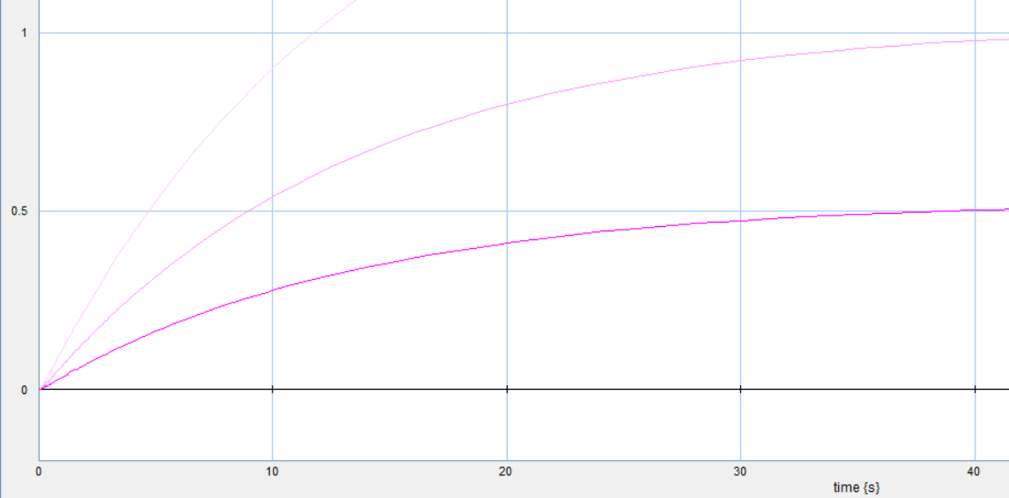
Problem statement: thumb servo second angle
Bond Graph Prosthetic Hand
Issue found
The second thumb angle responded much slower than the other joints.
At low voltage it needed around 40s to reach a significant angle.
Changing the available parameters did not solve this response in a physically meaningful way.
This issue is reported as the main remaining model limitation.
Team 5 | MCTR 1015 | 14

Slide 12
Validation, discussion and conclusion
Bond Graph Prosthetic Hand
40 N
0.835 s
12 V
force applied by the motor
in bachelor thesis validation
measured real-hand
flexion time
closest strong-grip
simulation case
Validation method
Conclusion
Compare simulated joint-angle response with the physical prosthetic hand flexion test.
Use rise time, settling time and final angle as the main comparison points.
The simulated response is stable and reaches flexion in the same general time range.
The model successfully represents motor-driven tendon flexion of the fingers.
Battery discharge clearly reduces gripping capability.
The main remaining improvement is replacing the simplified servo second-angle model with a more realistic servo-control representation.
Team 5 | MCTR 1015 | 15

